Slide 1

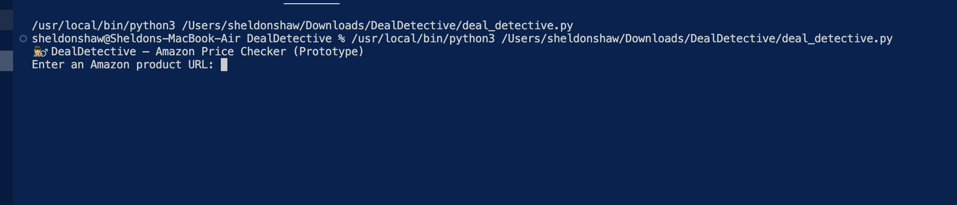
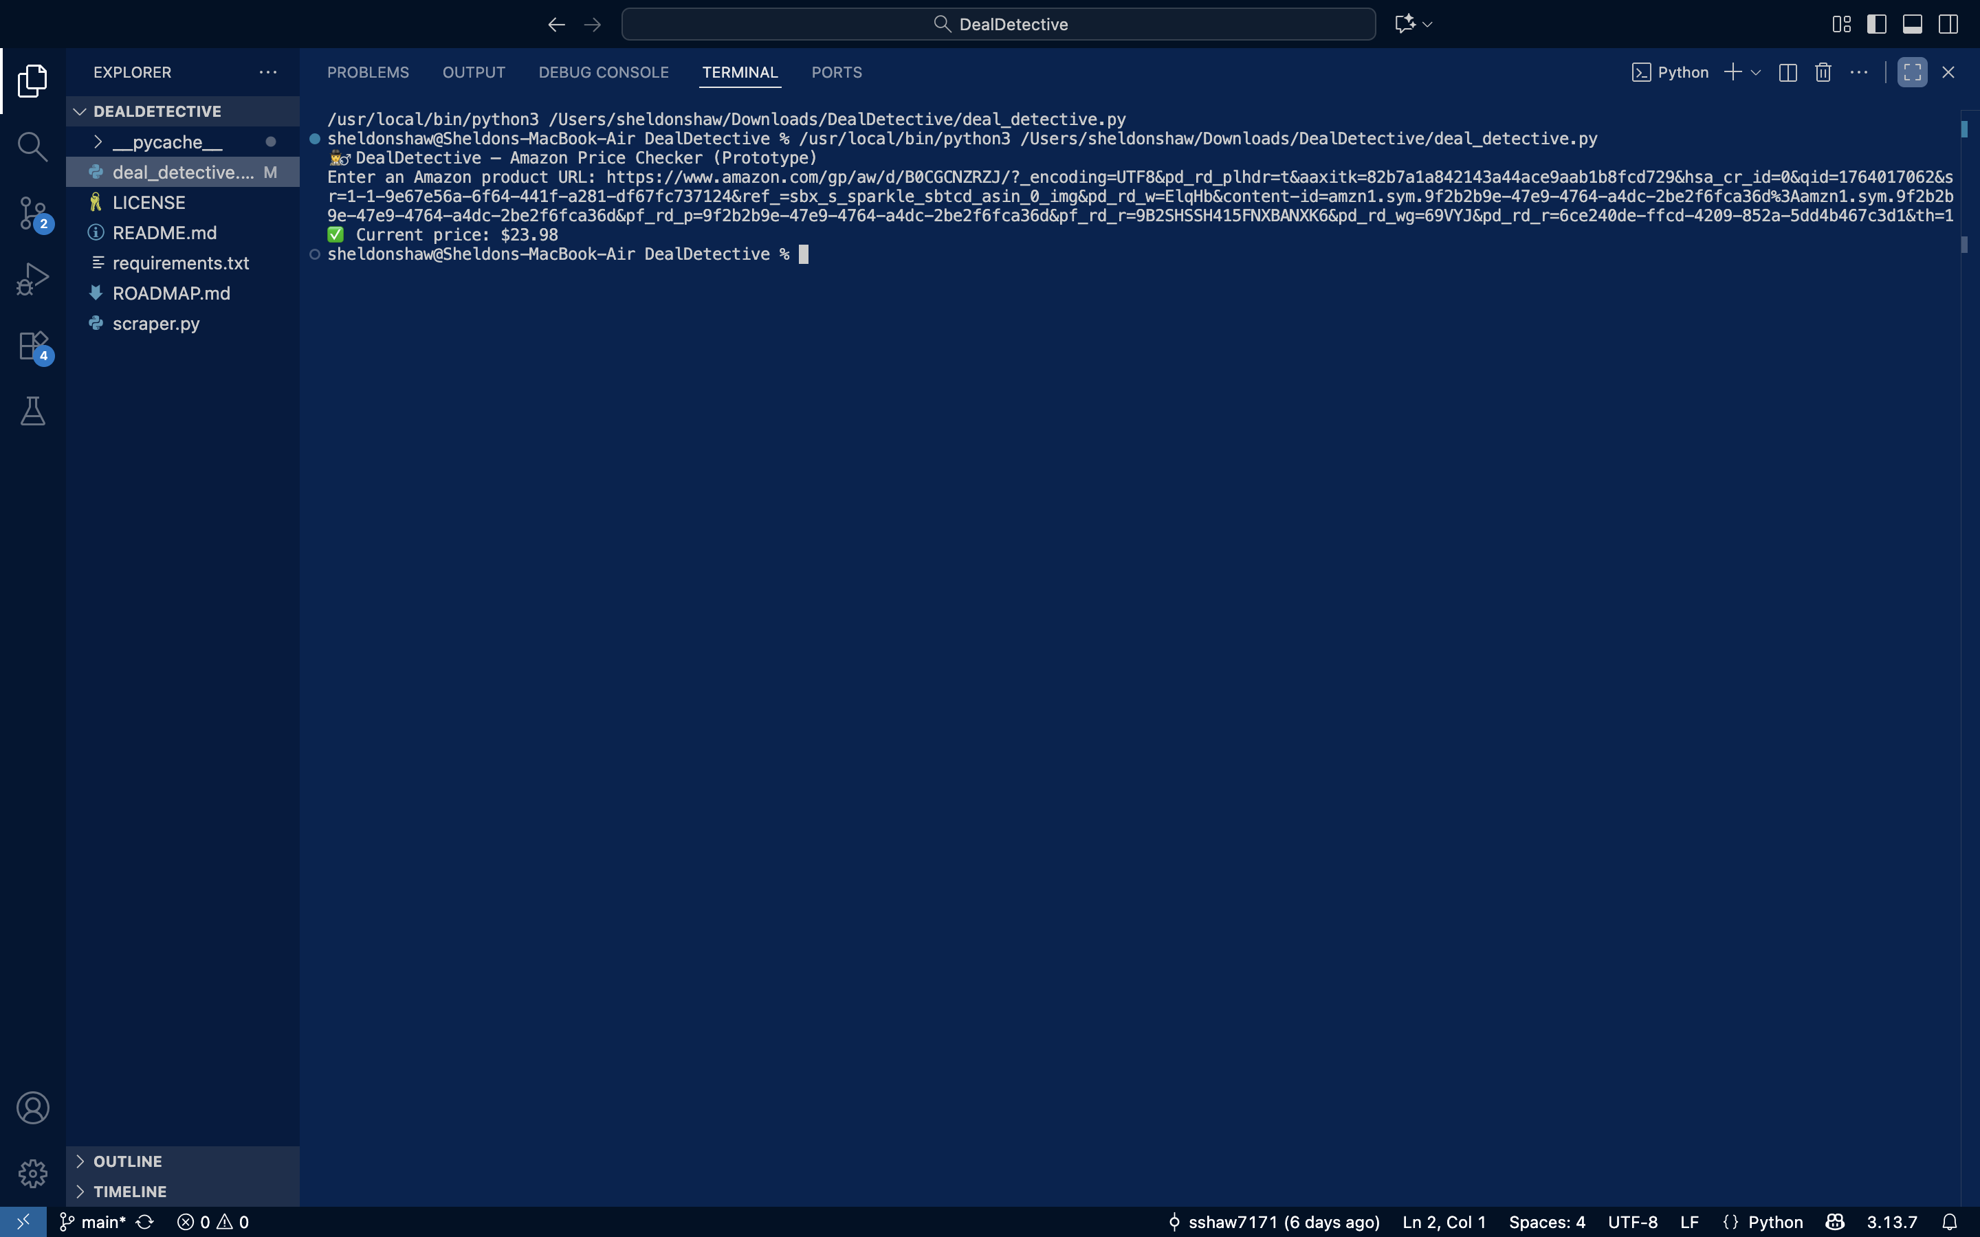
Deal Detective
“The best deals aren’t found — they’re detected”
DealDetective is an automated price-tracking tool that monitors Amazon product links and alerts users when prices drop. Built using Python and version-controlled through GitHub, the system helps shoppers make smarter buying decisions without constantly refreshing product pages
Step 1
Step 2

